Slide 1
Applications of text mining and NLP
Javier Garcia-Bernardo

Slide 2
Summary
Text -> Numeric:
TF; TF-IDF; Word embeddings
Similarity (often cosine similarity)
Clustering
TF-IDF + Dimensionality reduction (e.g. TruncatedSVD) + Clustering (e.g. K-Means)
Word embeddings + Clustering (e.g. K-Means)
Document-Term Matrix (CountVectorizer) + LDA
Classification
TF-IDF (+ Dimensionality reduction) + Classifier (e.g. LogisticRegression)
Word embeddings + Classifier (e.g. LogisticRegression)
Neural Networks (Feed-forward, RNN, LSTM, CNN, Transformers)
Tomorrow: Sentiment analysis

Slide 3
A collection of text mining applications
Similarity
Find authors of an anonymous book
Analyze experiments on information diffusion
Find duplicates and link records
Clustering
Targeted advertisement or learning or helper
Recommendation systems (e.g. similar books)
Clustering stories (clustering fiction works, people’s diagnoses, misinformation)
Track evolution of topics in discourse
Anomaly detection
Classification/Regression
Targeted advertisement
Hate speech classification (similar: spam, fake news, emergencies)
Tracking emotions (some emotions are highly correlated with YouGov surveys)
Predict student performance, probability of re-hospitalization, fraud (insurance or research)
Classifying reports (e.g. hospital discharges, urgent issues)
Predict stock market returns
Notes:
Groups, think 3 of each

Slide 4
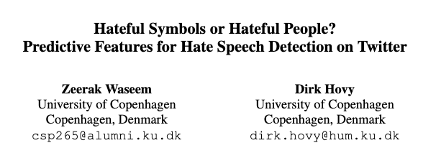
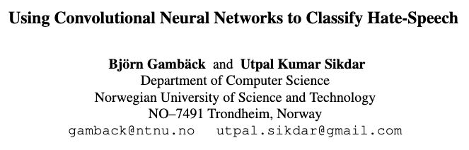
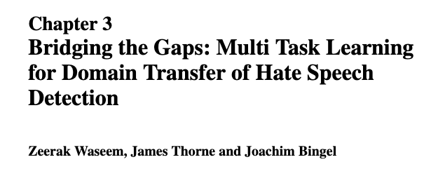
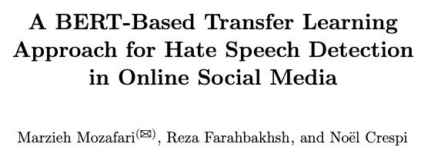
Applications in Social Media (Hate Speech in Twitter)
Notes:
2016
2016
2017
2019

Slide 5
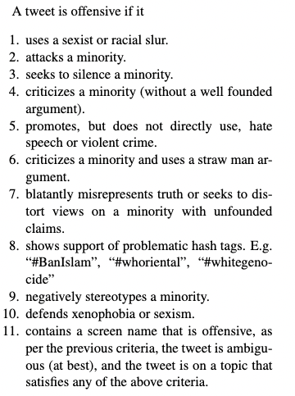
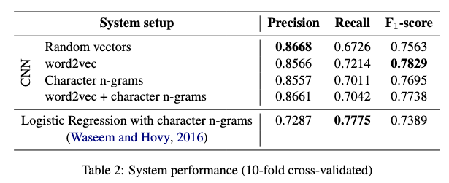
Waseem and Hovy, 2016
Data: Annotation of 16k tweets based on Gender studies and CRT
Method: TD-IDF using character {uni, bi, tri}-grams.
Why did they use characters instead of words?
Preprocessing: Removing stop words (except “not”), usernames and punctuation
Classifier: Logistic Regression
Results:
Notes:
When would you remove ”not” as a stop word?

Slide 6
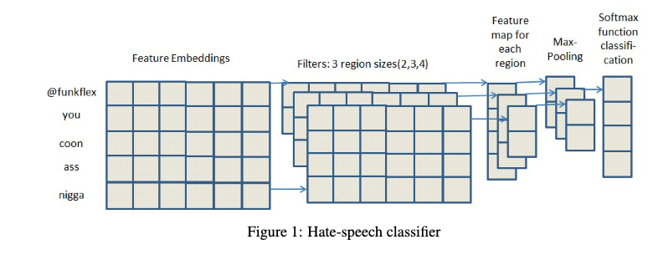
Gamback and Sikdar, 2017
Data: Waseem&Hovy (2016)
Method: CNN using word embeddings and character n-grams
Preprocessing: None
Classifier: Softmax
Results:

Slide 7
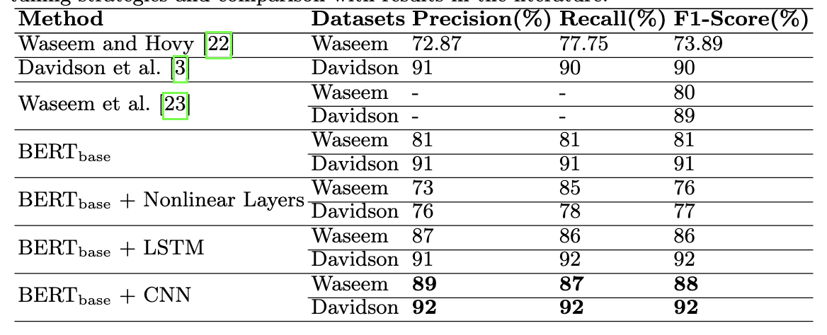
Waseem, Thorne and Bingel (2018)
Data: Waseem & Hovy (2016), 25k annotated tweets (Davidson et al, 2017; Twitter user guidelines)
Best method: Multi-task training. BoW words (5000), bigrams (5000) and character bi/tri-gram (5000)
Feed-forward neural network with 2 hidden layers. Softmax output
Preprocessing: Removing usernames, links and punctuation
Classifier: Softmax
Regularization: Dropout (20%)
Results:
Notes:
25k annotated tweets (92% agreement)
Method: word n-grams (1,2,3 characters) → Less psarse
TF-IDF: Yes
Other features
Classifier: (many) but L2 Logistic Regression best
0.91, 0.9, 0.9

Slide 8
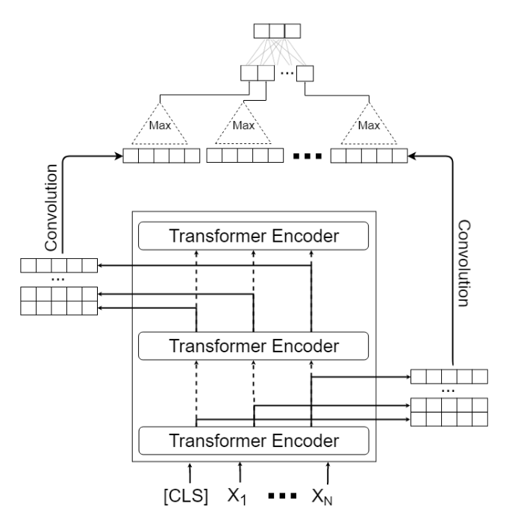
Mozafari, Farahbakhsh and Crespi (2019)
Data: Waseem & Hovy (2016), 25k annotated tweets (Davidson et al, 2017; Twitter user guidelines)
Best method: BERT + CNN
Each layer of the transformer gives an output → CNN
Preprocessing: Replacing usernames, elongated words, hashtags; remove punctuation
Classifier: Softmax
Regularization: Dropout (10%)
Results:
Notes:
25k annotated tweets (92% agreement)
Method: word n-grams (1,2,3 characters) → Less psarse
TF-IDF: Yes
Other features
Classifier: (many) but L2 Logistic Regression best
0.91, 0.9, 0.9

Slide 9
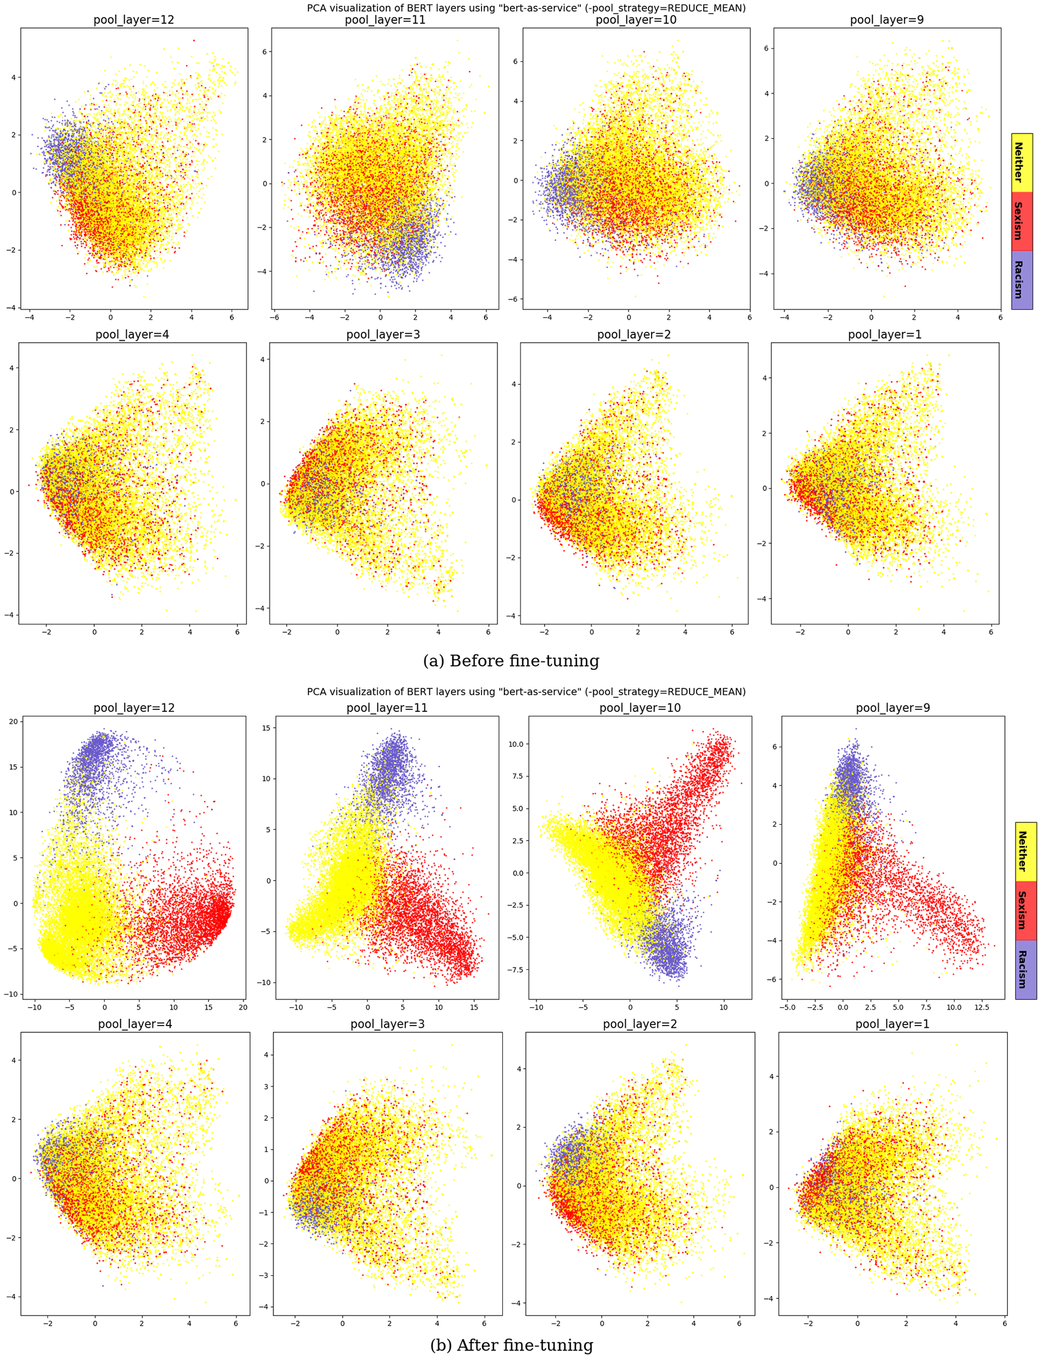
Base
BERT
Fine-tuned
BERT

Slide 10
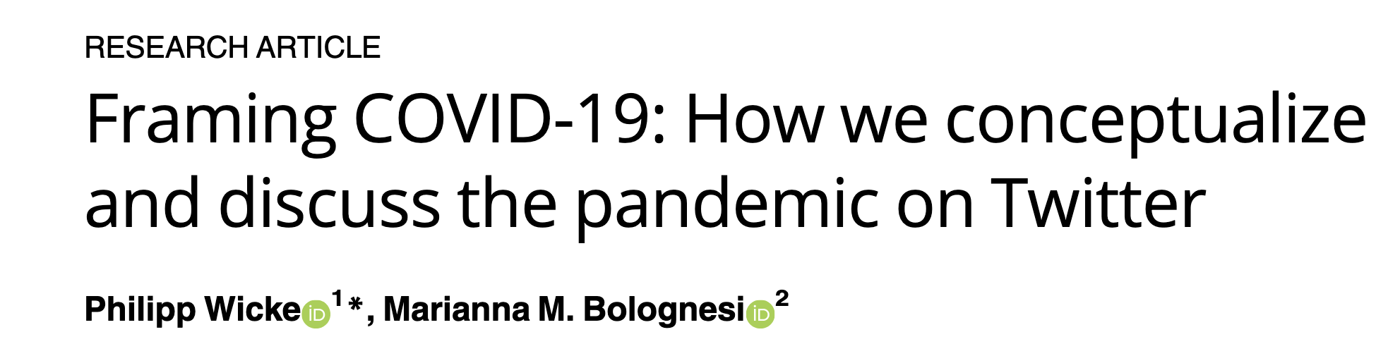

Application of Text Clustering in Media

Slide 11
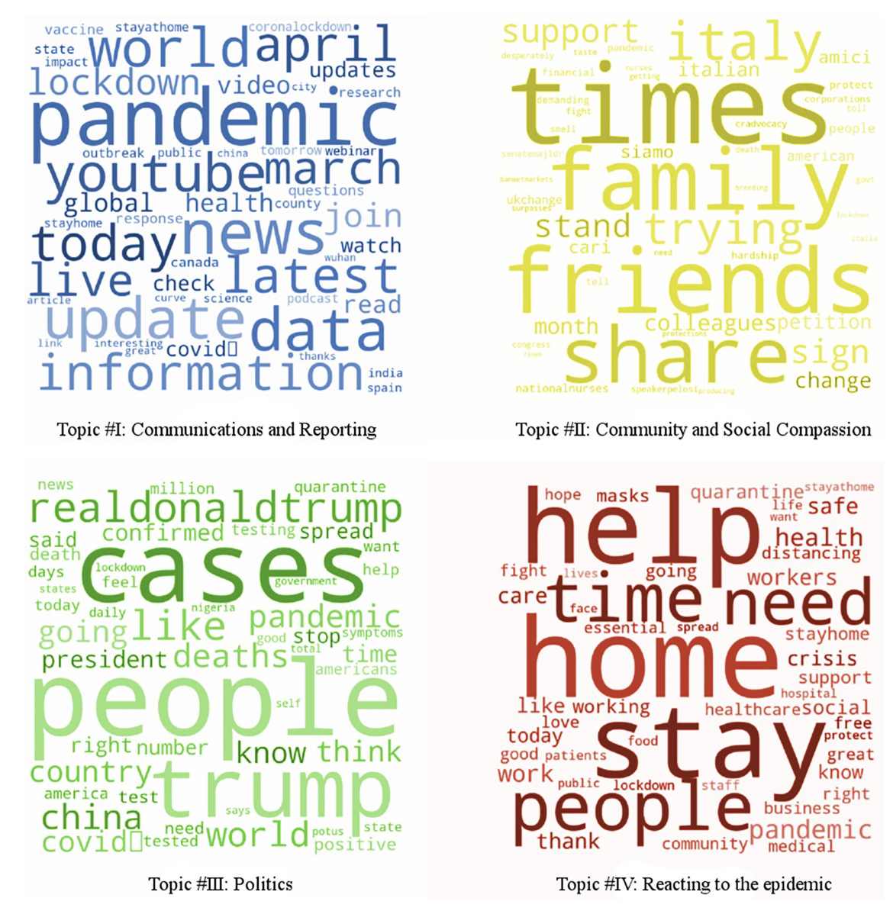
COVID pandemic (Wicke & Bolognesi 2020)
Question: What is the framing of the COVID pandemic? Framing of WAR (fight, combat, battle), STORM (wave, storm, cloud), MONSTER (evil, horror, killer) or TSUNAMI (wave, tragedy, catastrophe).
Data: Twitter around #Covid-19 (80 hashtags)
Method: LDA (4 and 16 topics) + correlation of topics with frames
Preprocessing: Remove stop words, remove covid, remove tokes with less than 3 characters
Validity assessed: Qualitatively + external sample.
Results:

Slide 12
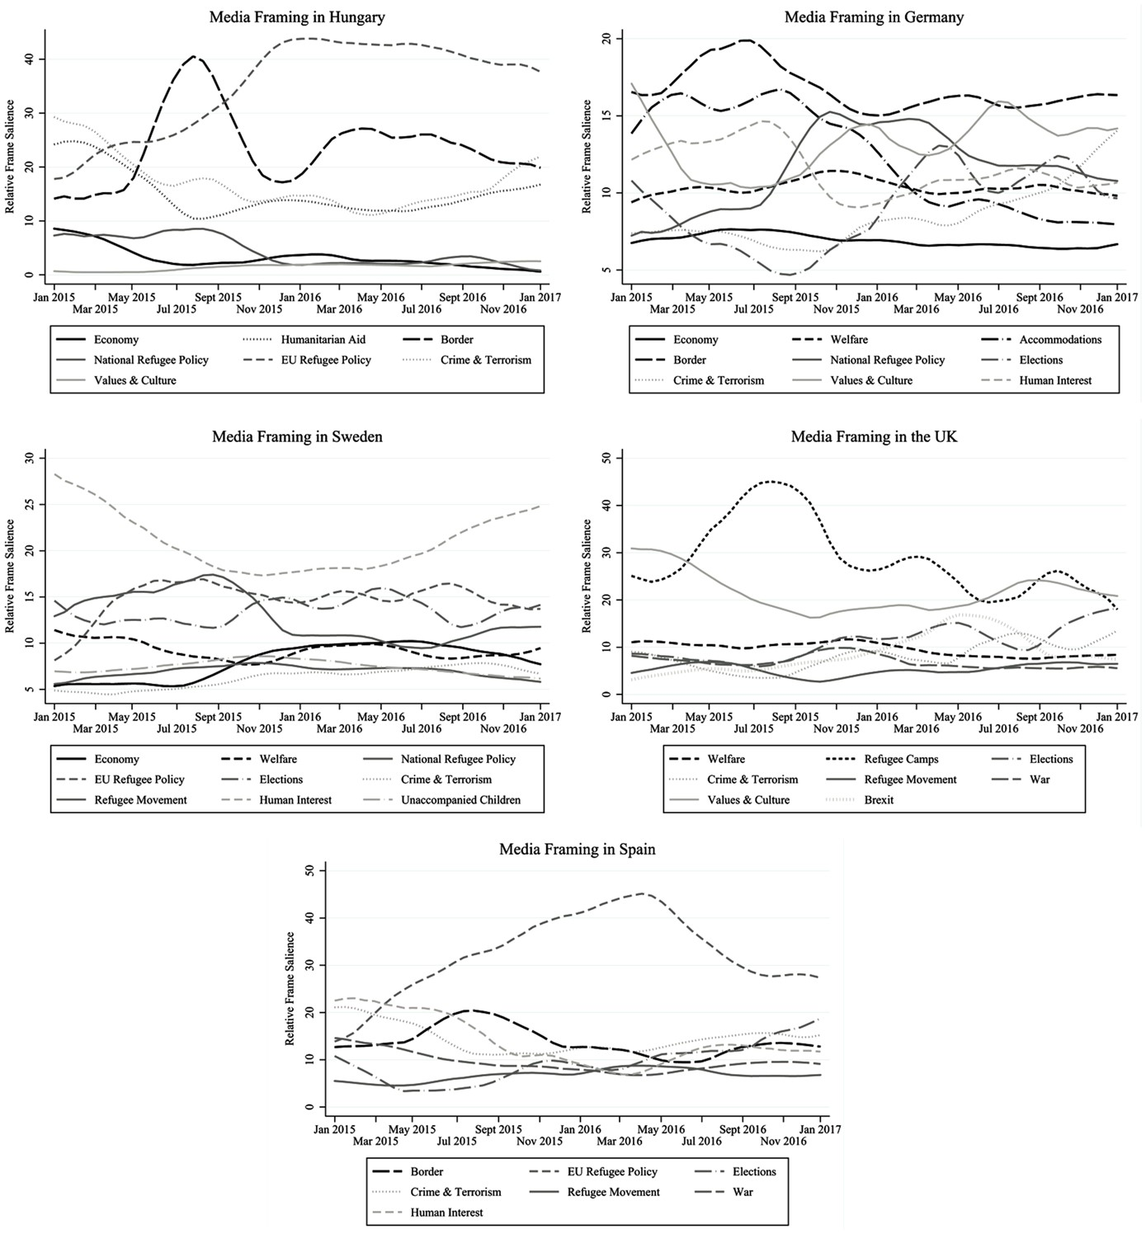
Refugees crisis (Heidenreich, Lind, Eberl & Boomgaarden, 2019)
Data: 130k articles from 24 news outlets
Method: LDA (10 topics per country) + manual labeling.
Preprocessing: Unclear
Validation: Semantic validity (are the topics distinctive) + Randomly reading three articles per topic/country + predictive validity (are important events such as elections reflected)
Results:
Notes:
Frequently found frames in migration coverage are the ‘Economy’ frame (e.g. migrant workers’ impact on the job market), the ‘Welfare’ frame (i.e. migrants’ impact on the welfare system), crime and security-related perspectives and an emphasis on political and legal processes (e.g. Gabrielatos and Baker 2008; McLaren et al. 2018

Slide 13
Similarity between texts
Find authors of an anonymous book
Analyze experiments on information diffusion
Find duplicates

Slide 14
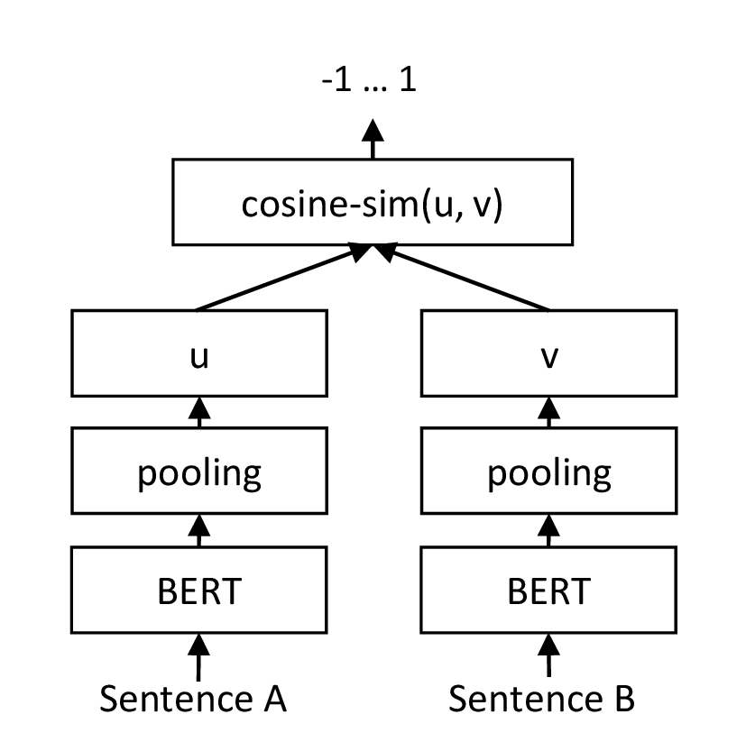
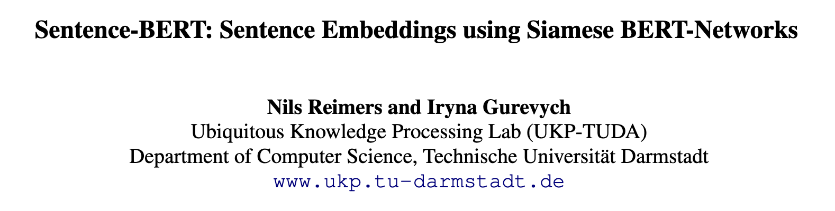
How to measure similarity between sentences?
Option 1: Cosine similarity TF-IDF representations
Option 2: Average word embeddings, cosine similarity. Works only for small sentences.
Option 3: Train BERT, pass two sentences (but creates one embedding for the combination)
Option 4: Siamese BERT-Networks: Pre-trained only on books + Wikipedia (via BERT) and on NLI data (sentence pairs)

Slide 15
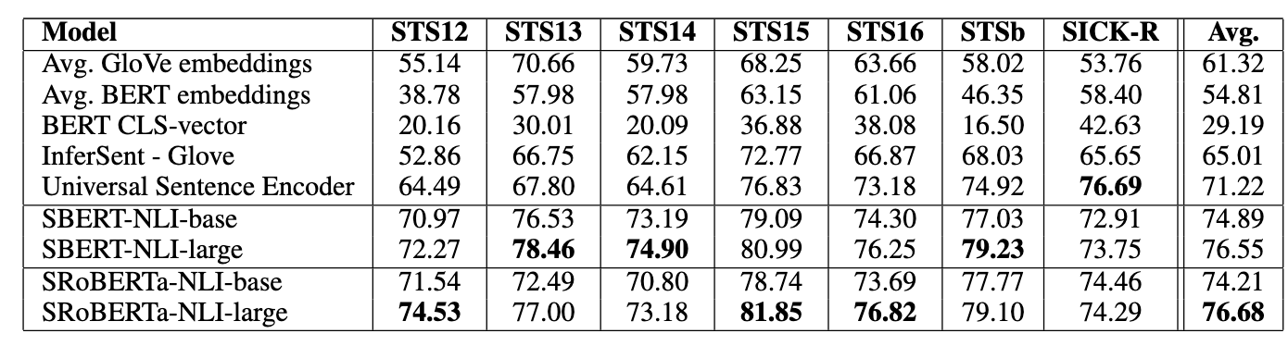
Sentence similarity
Notes:
This way, in BERT, the masking is performed only once at data preparation time, and they basically take each sentence and mask it in 10 different ways. Therefore, at training time, the model will only see those 10 variations of each sentence.
On the other hand, in RoBERTa, the masking is done during training. Therefore, each time a sentence is incorporated in a minibatch, it gets its masking done, and therefore the number of potentially different masked versions of each sentence is not bounded like in BERT.

Slide 16
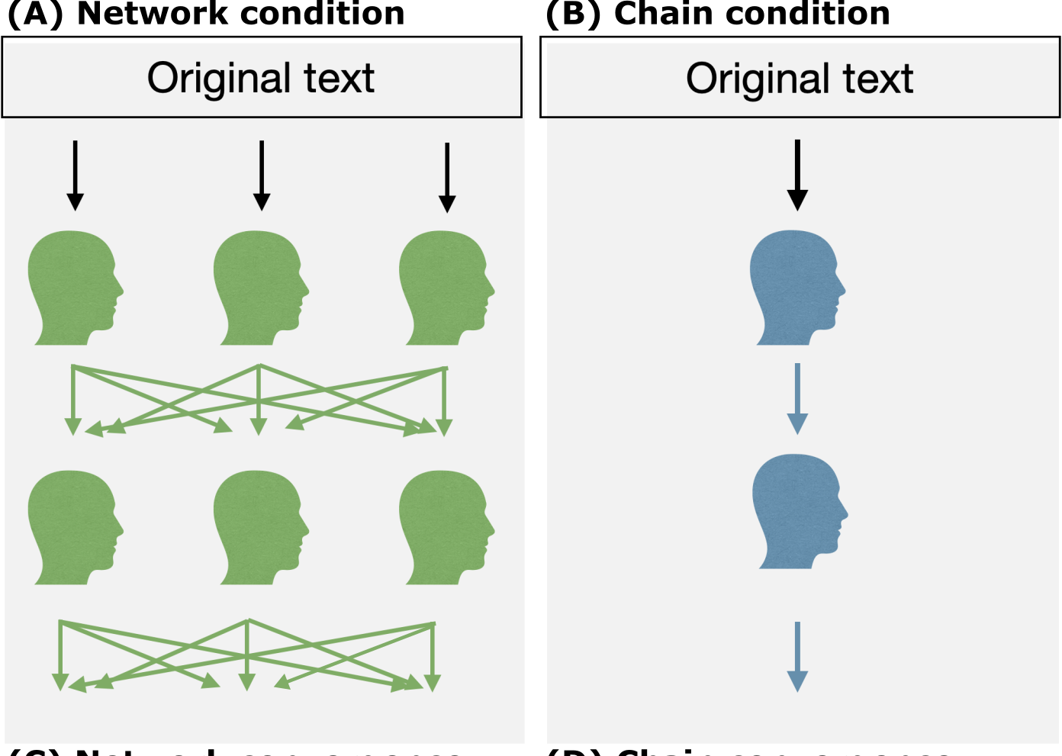
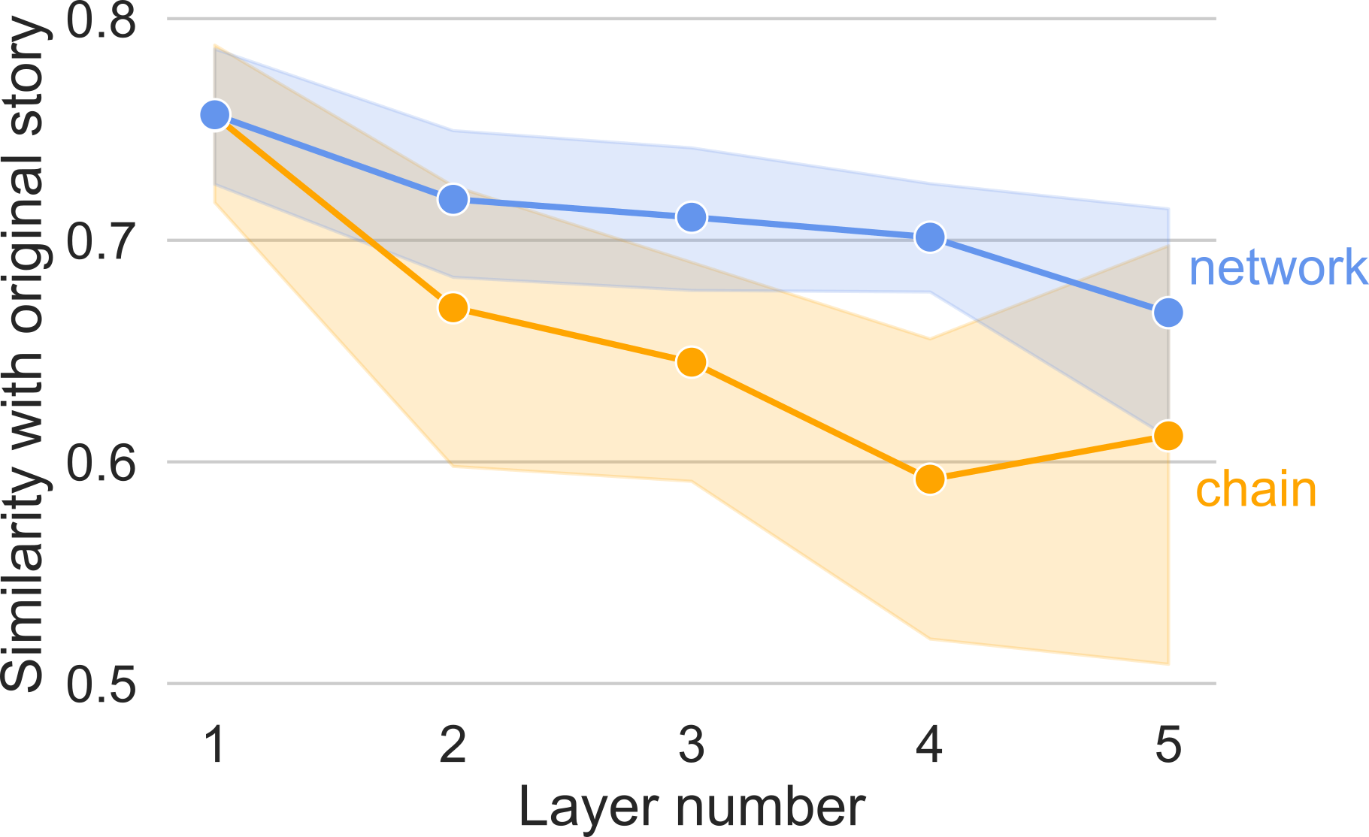
Application: Analyzing experiment data
Aloric, Garcia-Bernardo, Krafft, Hardy, Morgan, Neu, Santoro (202x)
Question: Understand effect of network structure on information diffusal
Hypothesis 1: Network helps preserve more information
Hypothesis 2: Network structure helps preserve “the essence” of the story
If true: Independent replicates should be more correlated
Data/experimental design:

Slide 17
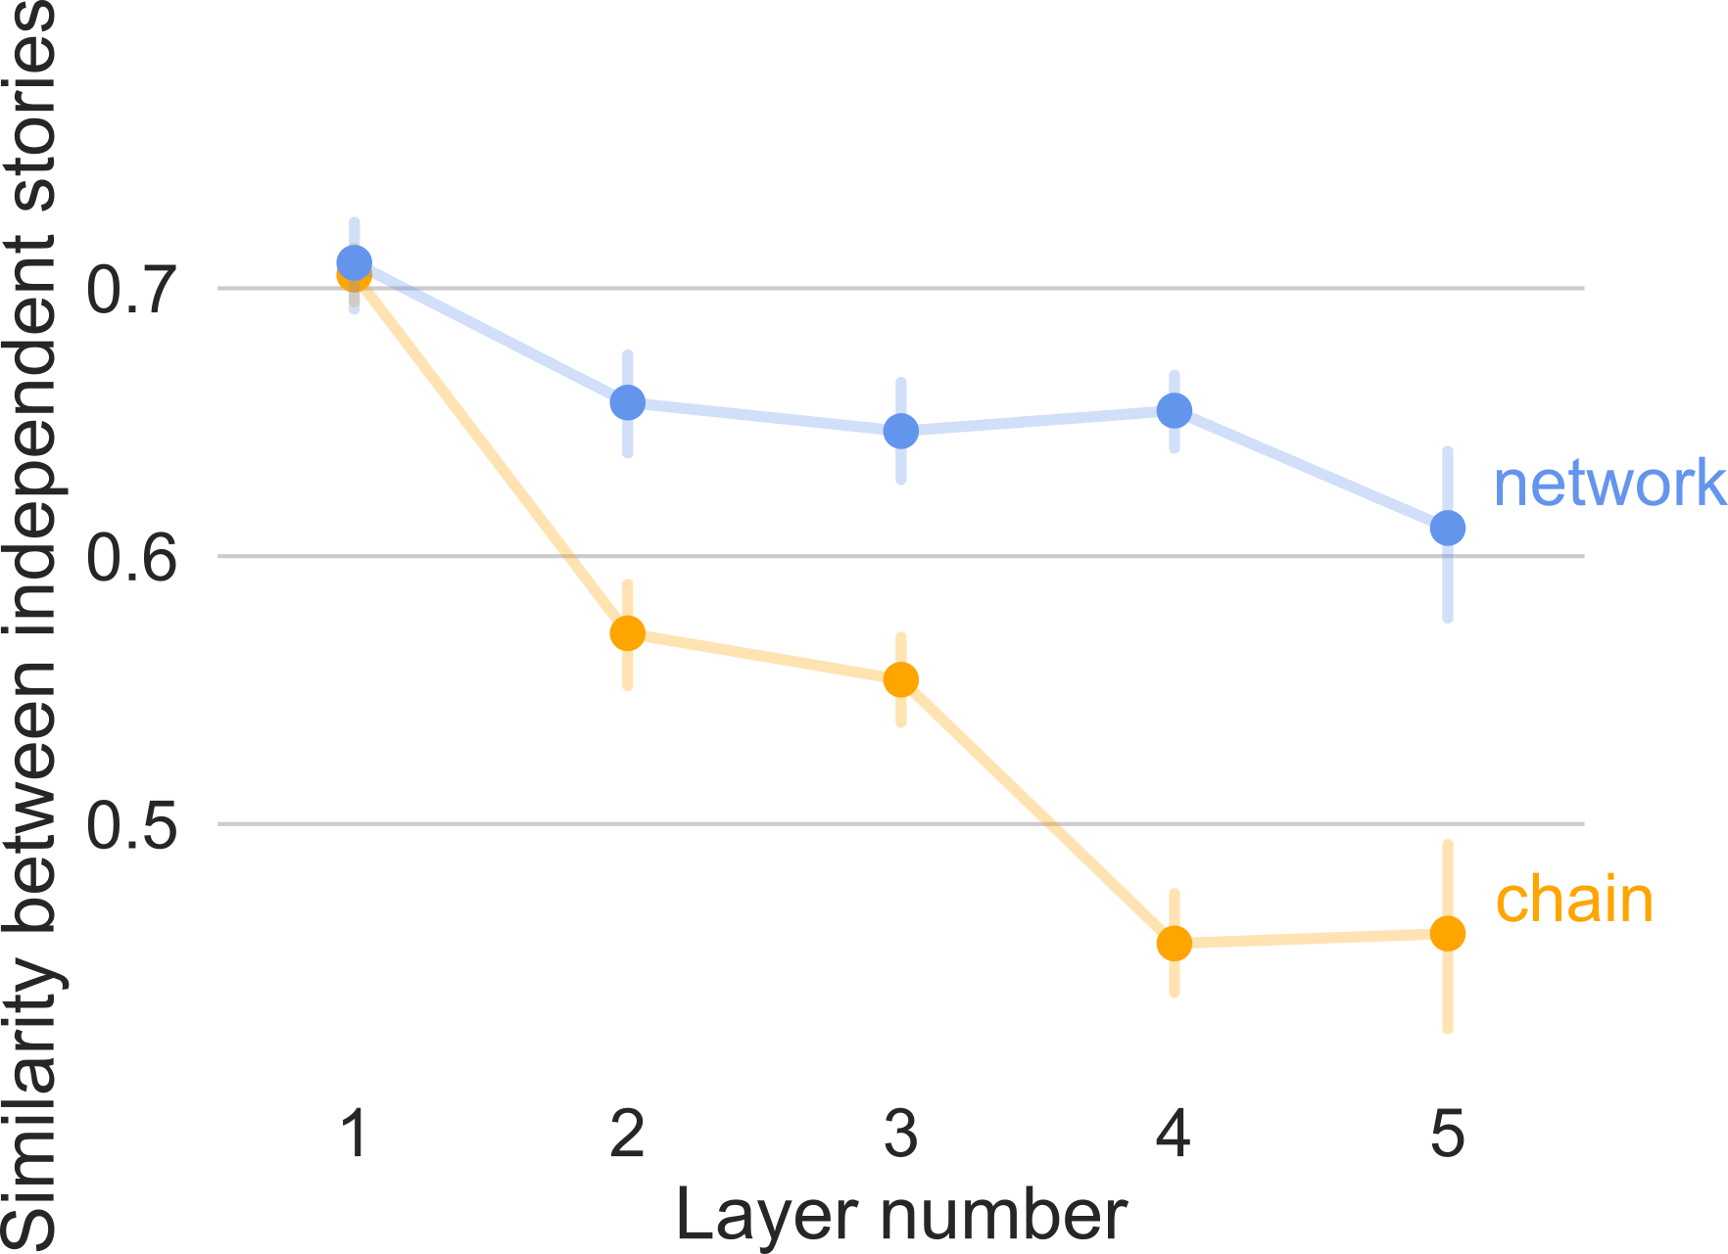
Between-replicates similarity

Slide 18
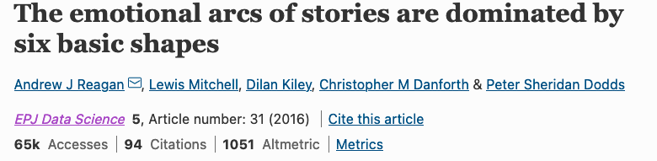
Applications in Humanities

Slide 19
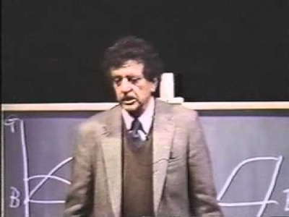
‘There is no reason why the simple shapes of stories can’t be fed into computers, they are beautiful shapes.’
- Kurt Vonnegurt

Slide 20
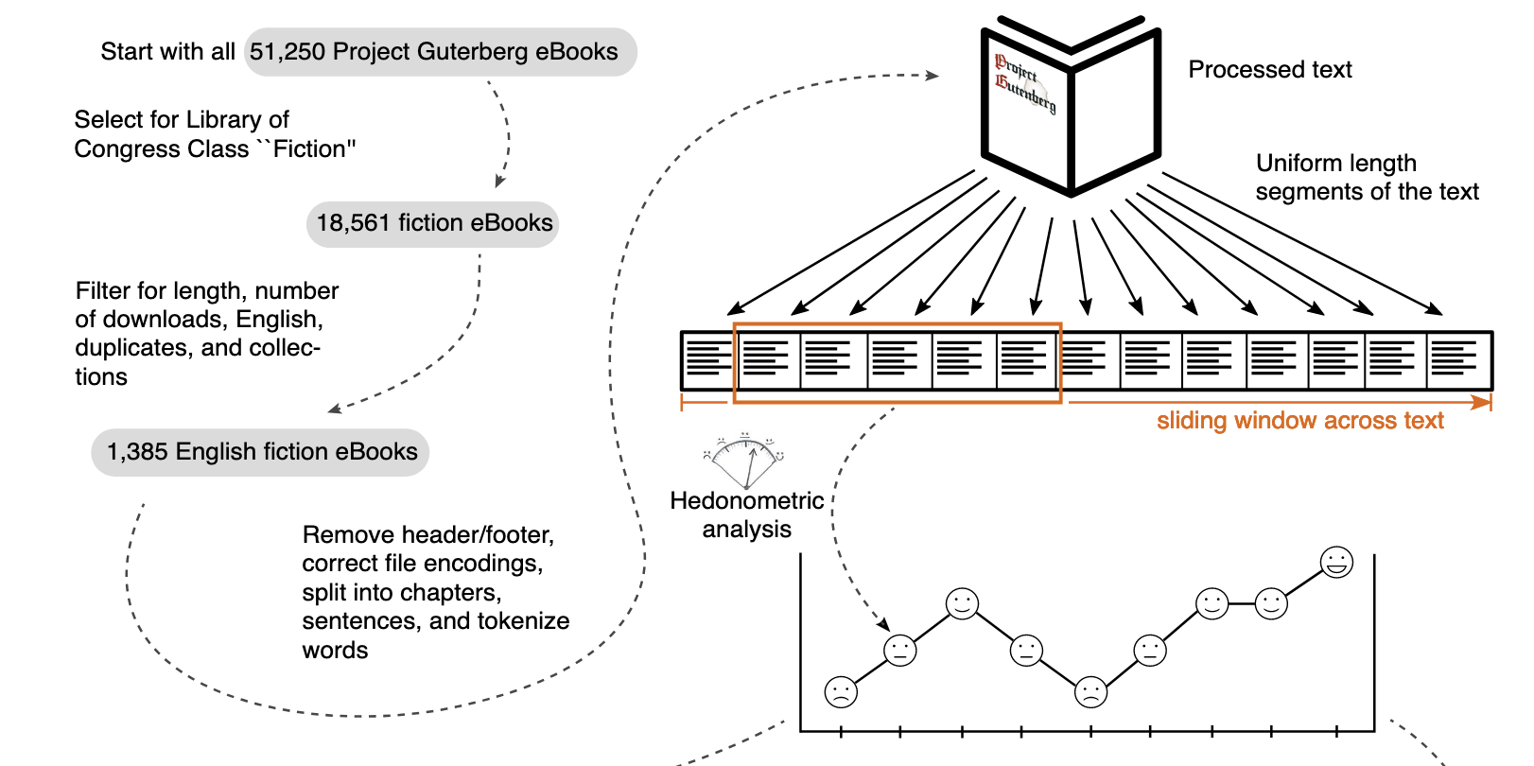

Slide 21
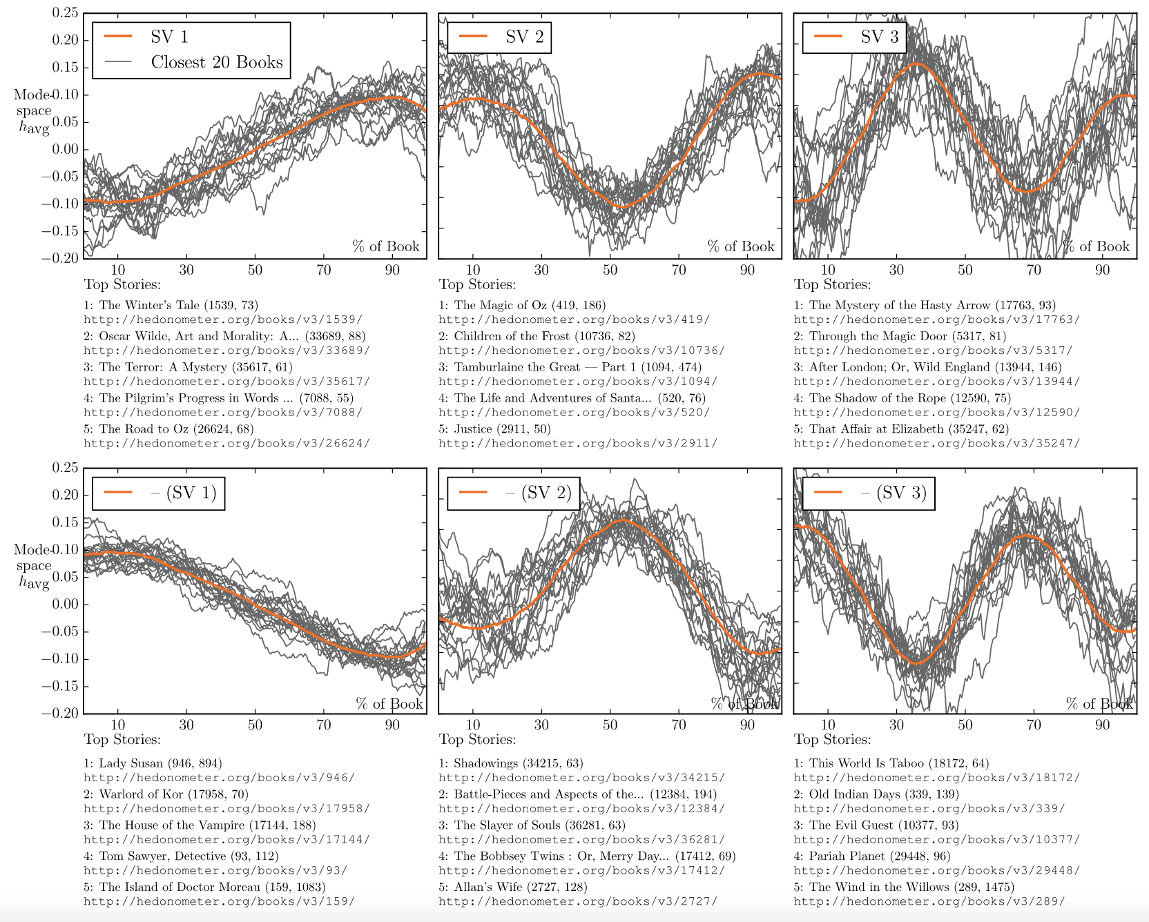
Rags to riches
Man in a hole
Cinderella
Tragedy
Icarus
Oedipus
Consideration of the emotional arc for a given story is important for the success of that story

Slide 22
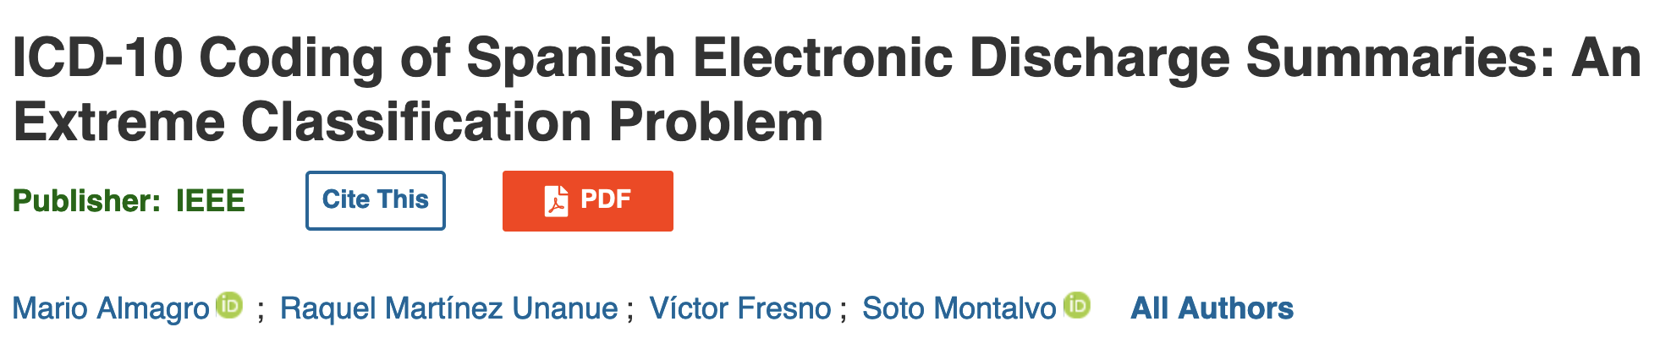
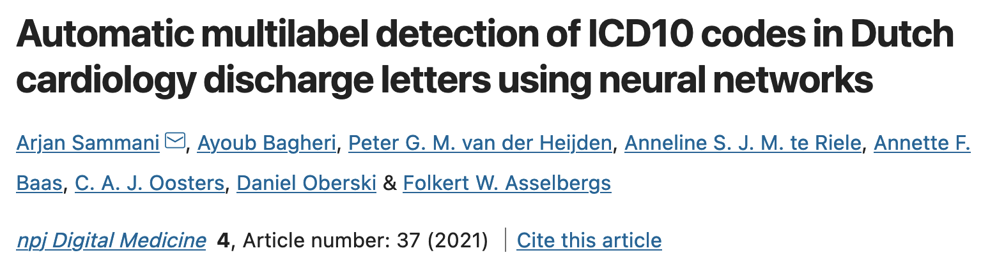
Applications in Health: Automating coding

Slide 23
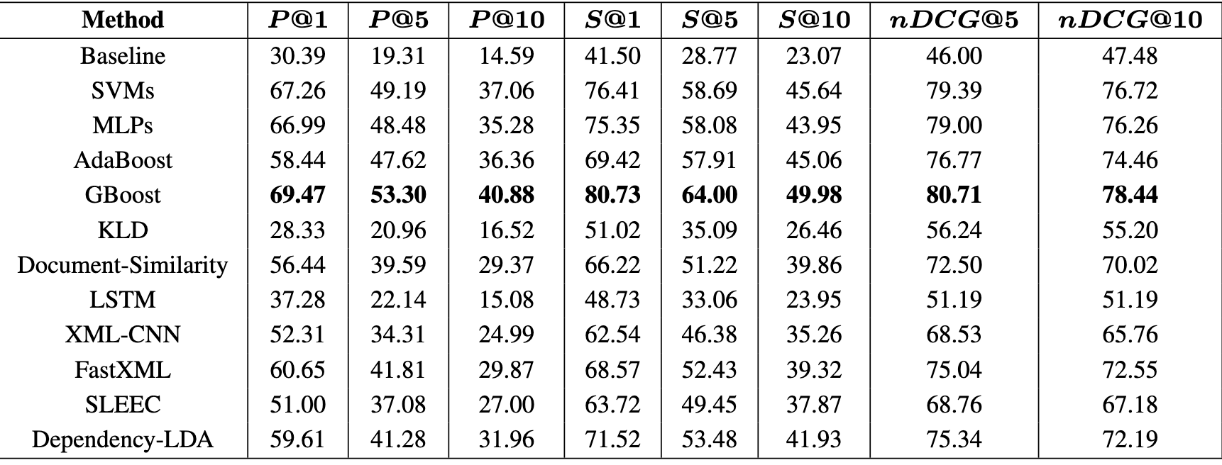
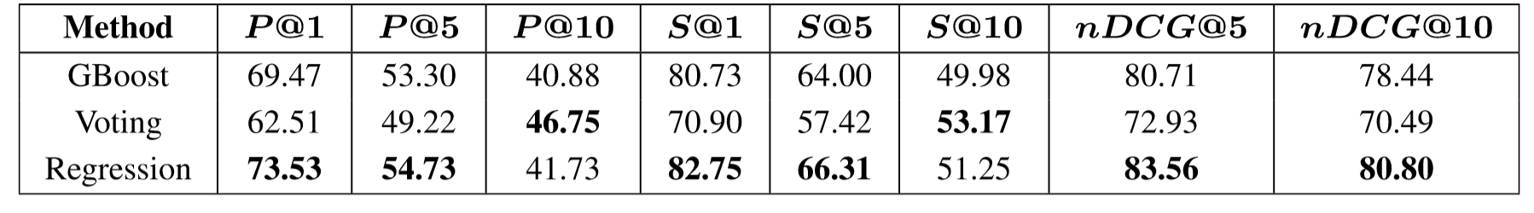
Almagro, Martínez-Unanue, Fresno, Moltalvo, 2020
Goal: Suggest a list of the 10 most probable ICD-10 codes (diseases, abnormal findings, causes of injury…) to experts
Data: 7k discharged reports, with 7k ICD-10 codes. Cardinality= 10.
Method: Different methods
Preprocessing: Remove sentences withoug technical terms (using tagging software), removal accents, punctuation, stemming.
Results:
Notes:
Baseline = most frequent

Slide 24
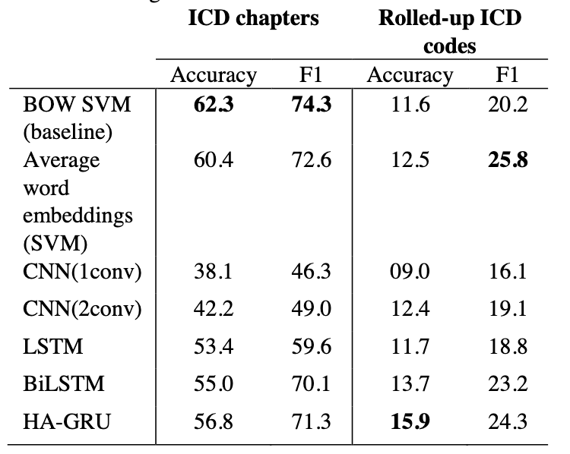
Bagheri, Sammani, van der Heijden, Asselbergs, Oberski, 2020
Question: The proposal is conceived to be applied in a real system, suggesting a list of the 10 most probable codes to experts
Data: 6k discharged reports, with 1k ICD-10 (diseases, abnormal findings, causes of injury…). Cardinality=5
Method: Different methods
Preprocessing: removed small labels, trimmed whitespaces, numbers and converted all characters to lowercase
Results:

Slide 25
Detecting unique patterns in text

Slide 26
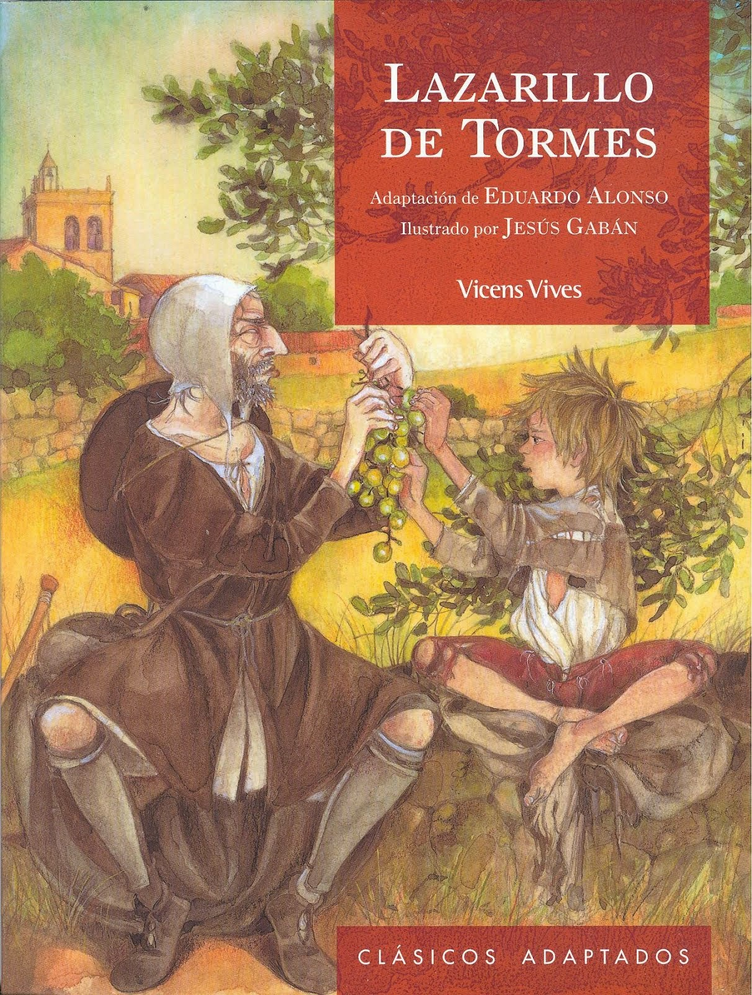
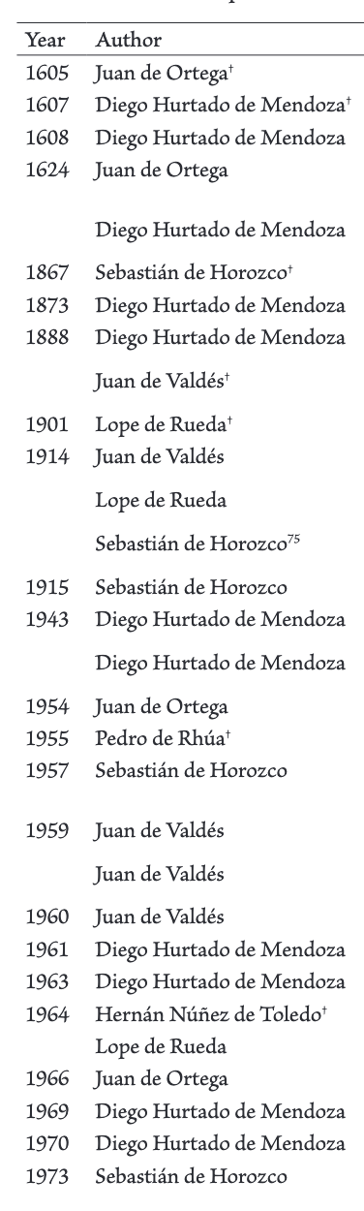
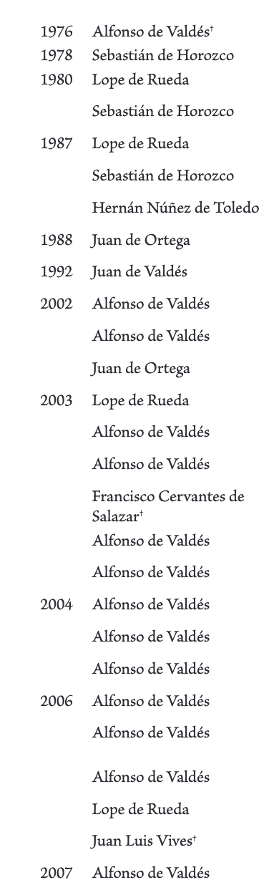
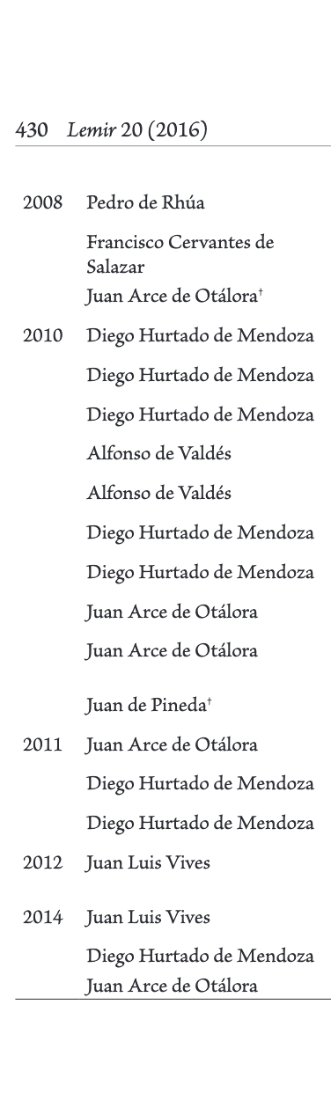
1554
Notes:
published anonymously because of its anticlerical content. founding a literary genre, the picaresque novel, Huckleberry Finn

Slide 27
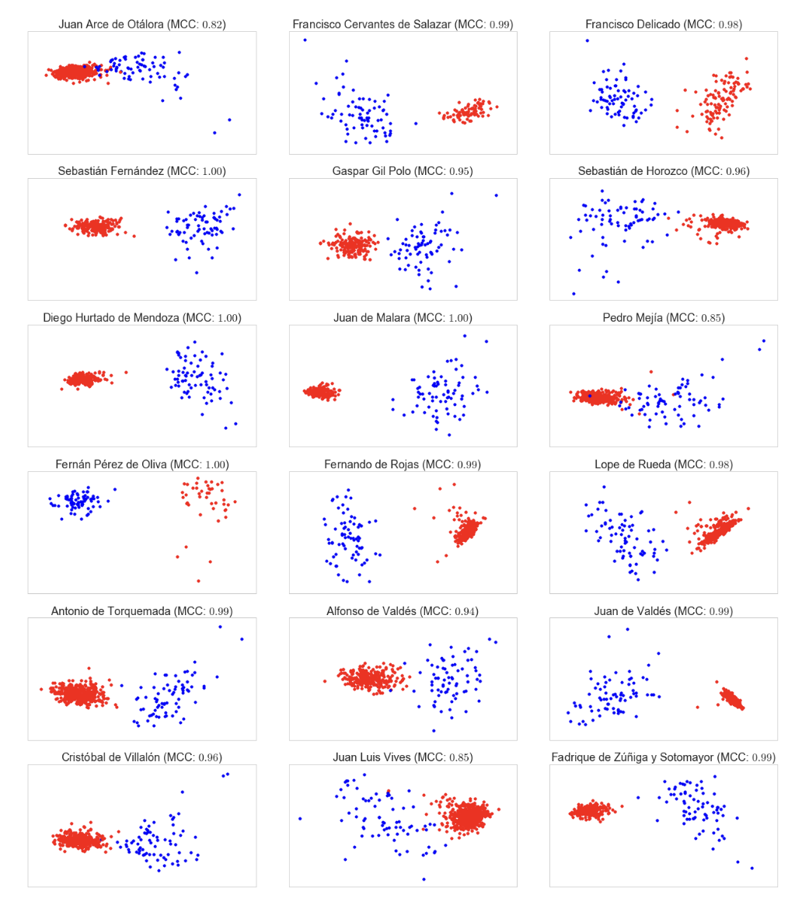
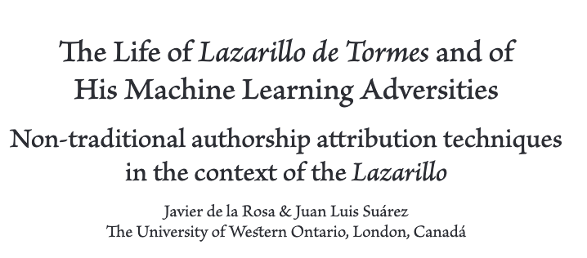

Slide 28
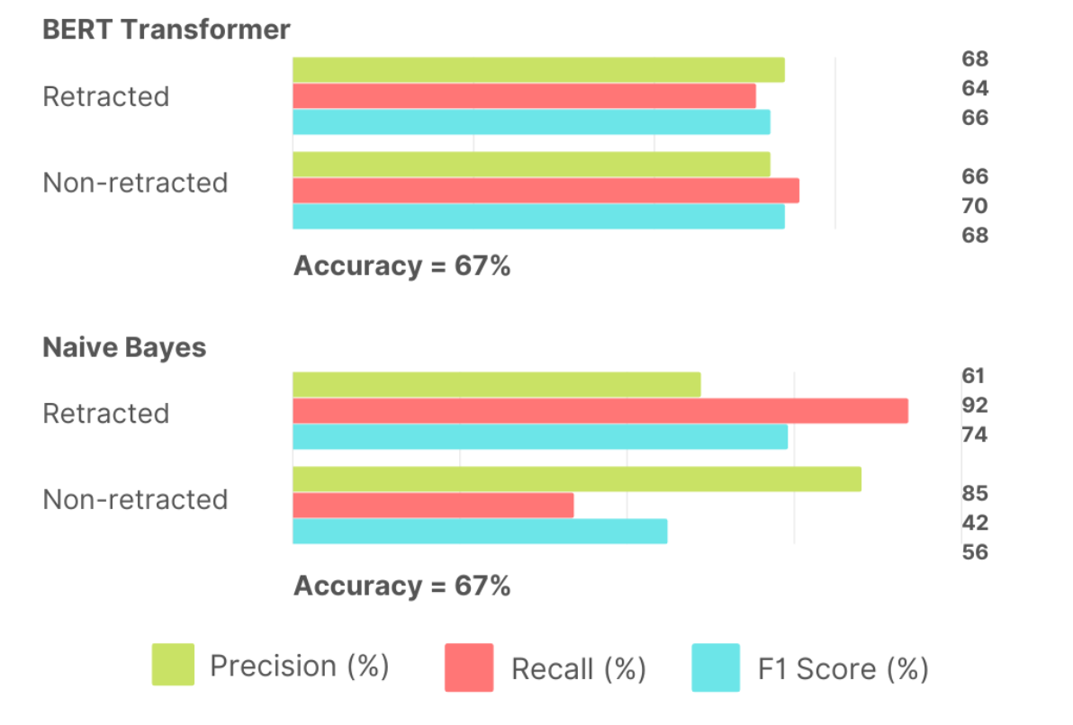
Detecting fraudulent research (Joep Franssen, Eveline Schmidt, Arleen Lindenmeyer, 2022)
Data: 1k retracted papers, 1k non-retracted papers from same journals
Method: Different methods (TF-IDF + NB, BERT)
Preprocessing: (1) none, (2) lemmatization, stop word removal, punctuation removal, lowercasing, and removal of white spaces (and tabs). We also removed proper nouns and deleted all numbers.
Results:

Slide 29
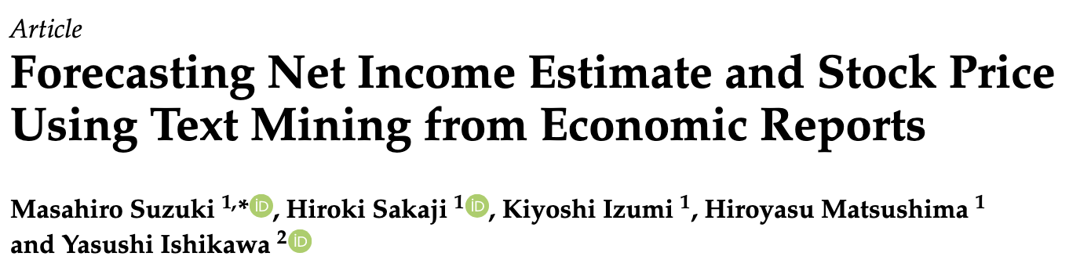
Applications in Economics and Finance

Slide 30
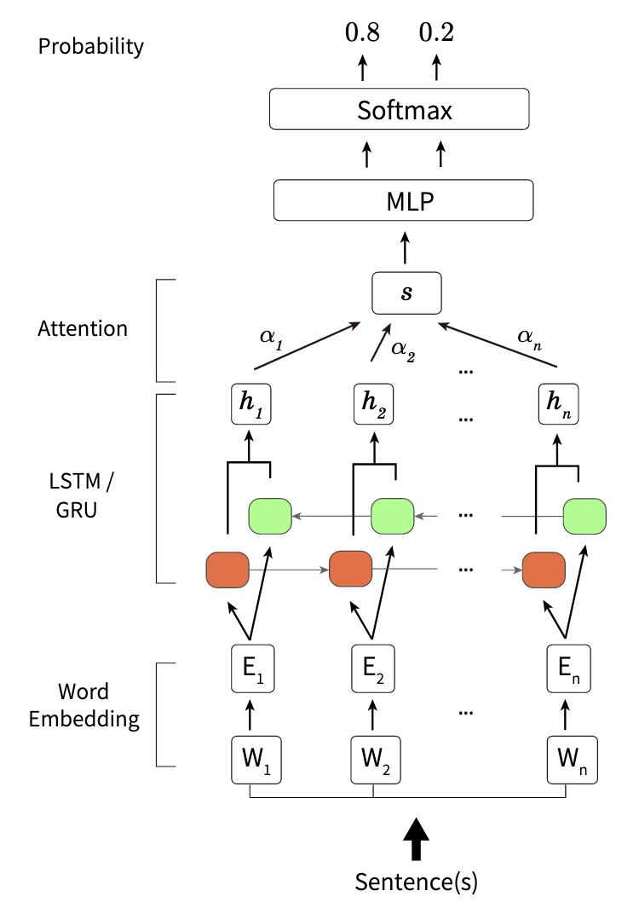
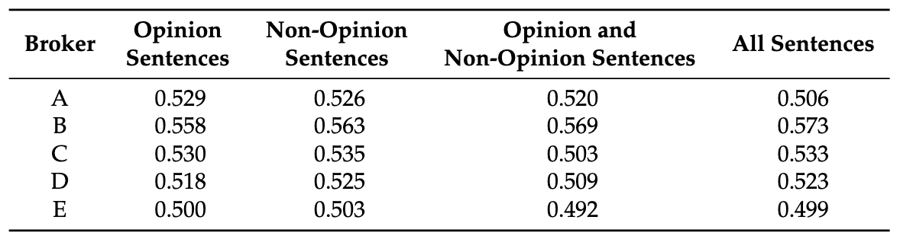
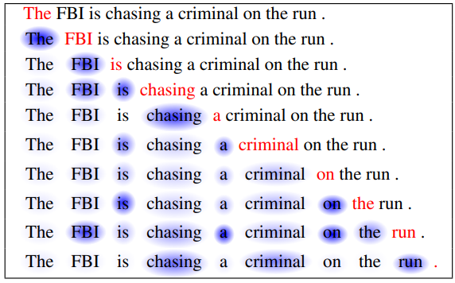
Suzuki, Sakaji, Izumi, Matsushima, Ishiwaka, 2020
Data: 17k reports on TOPIX securities from 5 brokers
Method: LSTM/GRU + Self-attention
Preprocessing: decomposing sentences into words (the Japanese language does not have spaces between the words in a sentences)
Goal: Predict excess return (+/-) at 14 days
Results:

Slide 31
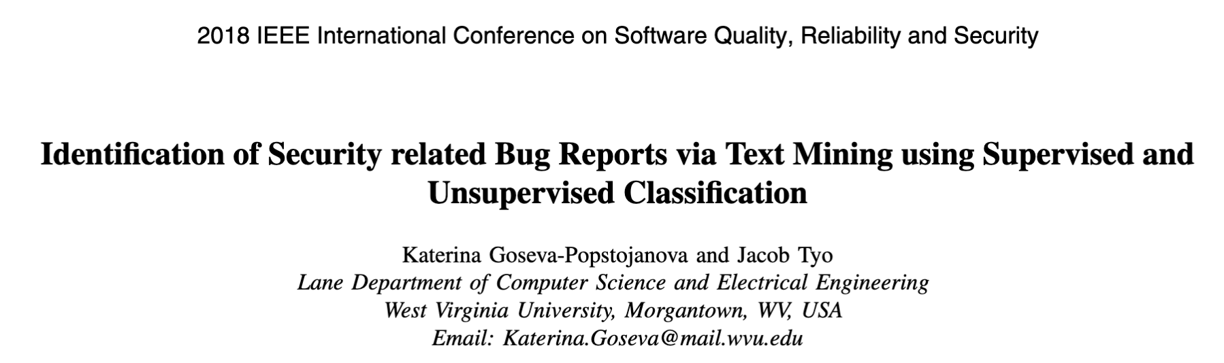
Applications in reports
Automatically code reports, detect emergencies

Slide 32
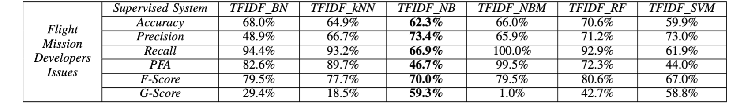
Goseva-Popstojanova and Tyo, 2018
Data: 3,500 issue tracking systems of two NASA missions
Method: TF-IDF/TF + ML (Bayesian Network (BN), k-Nearest Neighbor (kNN), Naïve Bayes (NB), Naive Bayes Multinomial (NBM), Random Forest (RF), and Support Vector Machine (SVM))
Preprocessing: remove punctuation, characters and stop-words, stemming
Goal: Identify those software bugs reports that are security related
Results:

Slide 33
How to know if your results make sense?
Clustering:
Classification/Regression

Slide 34
@ttnphns;
1. Cluster metaphor. "I preferred this method because it constitutes clusters such (or such a way) which meets with my concept of a cluster in my particular project". Each clustering algorithm or subalgorithm/method implies its corresponding structure/build/shape of a cluster.
2. Data/method assumptions. "I preferred this method because my data nature or format predispose to it".
3. Internal validity. "I preferred this method because it gave me most clear-cut, tight-and-isolated clusters. [Beware of overfitting: all clustering methods seek to maximize some version of internal validity (it's what clustering is about), so high validity may be partly due to random peculiarity of the given dataset; having a test dataset is always beneficial.]
4. External validity. "I preferred this method because it gave me clusters which differ by their background or clusters which match with the true ones I know". If a clustering partition presents clusters which are clearly different on some important background (i.e. not participated in the cluster analysis) characteristics then it is an asset for that method which produced the partition.
5. Cross-validity. "I preferred this method because it is giving me very similar clusters on equivalent samples of the data or extrapolates well onto such samples. Two main approaches are stability check and generalizability check.
6. Interpretation. "I preferred this method because it gave me clusters which, explained, are most persuasive that there is meaning in the world". It's not statistical - it is your psychological validation.
7. Gregariousness. "I preferred this method because it gave with my data similar results with a number of other methods among all those I probed". This is a heuristic but questionable strategy which assumes that there exist quite universal data or quite universal method.
https://stats.stackexchange.com/questions/195456/how-to-select-a-clustering-method-how-to-validate-a-cluster-solution-to-warran

Slide 35
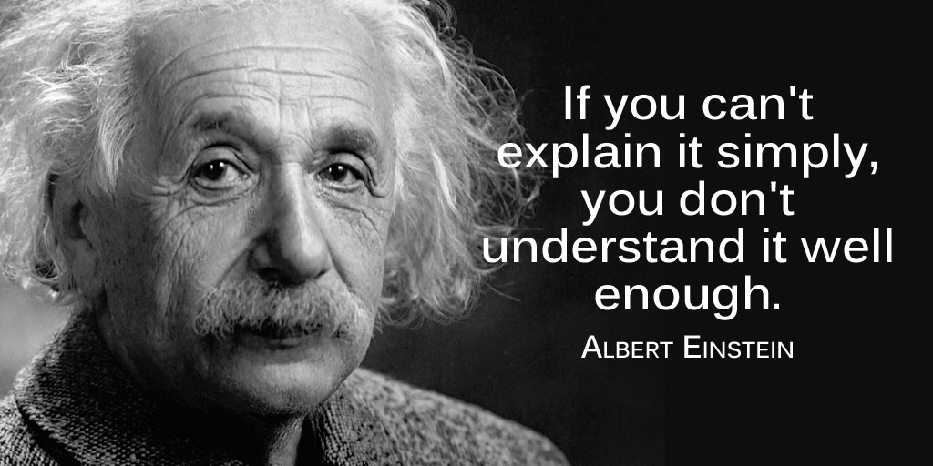
Interpretability in Supervised Learning
Notes:
Being Right for the Right Reasons

Slide 36
Interpretability
Being Right for the Right Reasons
Choices:
Global vs Local interpretability
Model-dependent vs model-agnostic interpretability

Slide 37
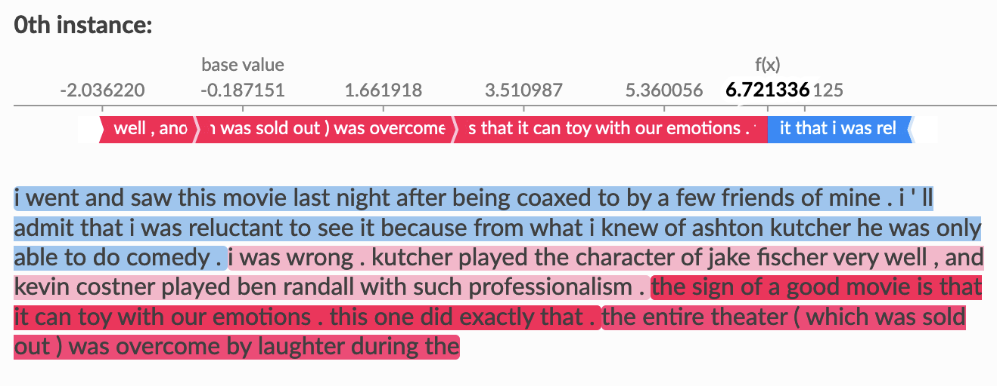
Local interpretability
Goal: Inform the human about the factors determining the prediction
Many advances in the last decade (SHAP, LIME, Anchors, Counterfactuals)
Basic idea: Change the observations slightly to observe how the prediction will change
https://shap.readthedocs.io/en/latest/example_notebooks/text_examples/sentiment_analysis

Slide 38
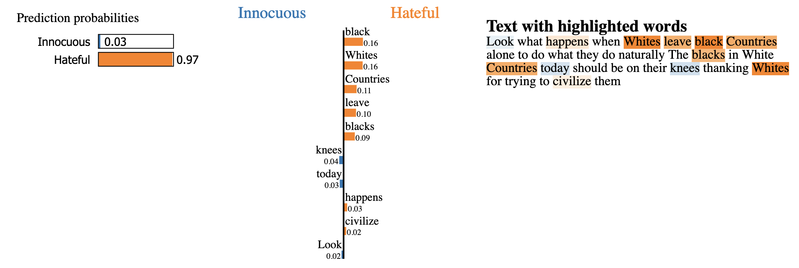
Local interpretability
Goal: Inform the human about the factors determining the prediction
Many advances in the last decade (SHAP, LIME, Anchors, Counterfactuals)
Basic idea: Change the observations slightly to observe how the prediction will change

Slide 39
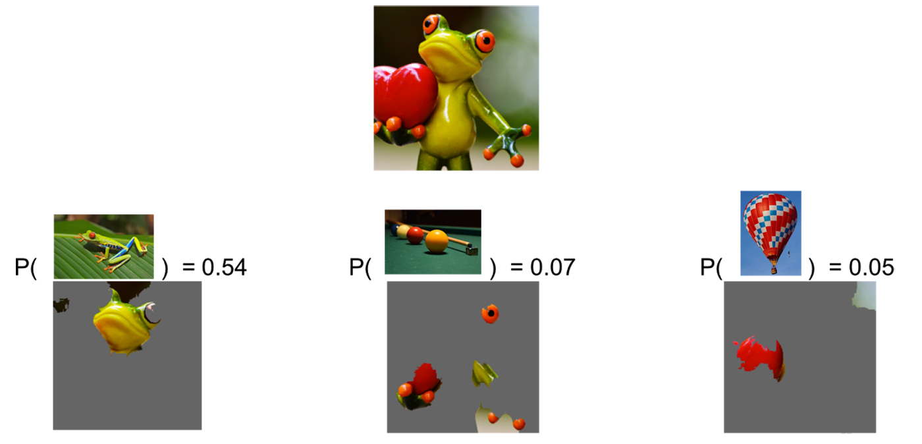
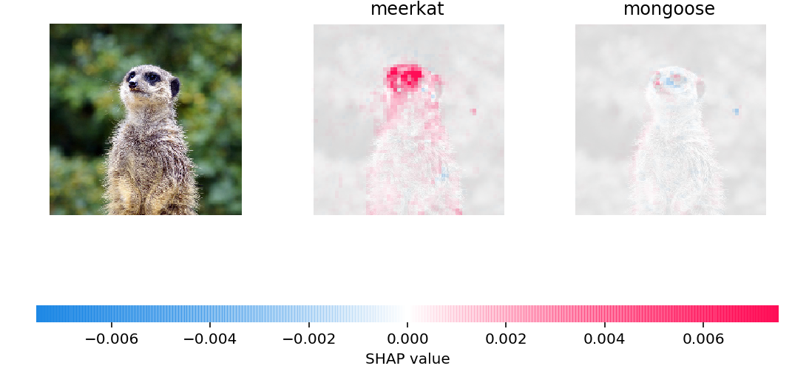
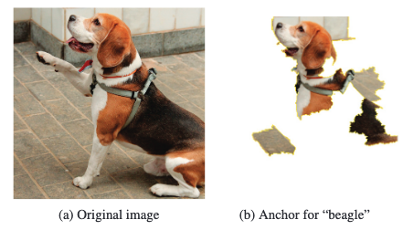
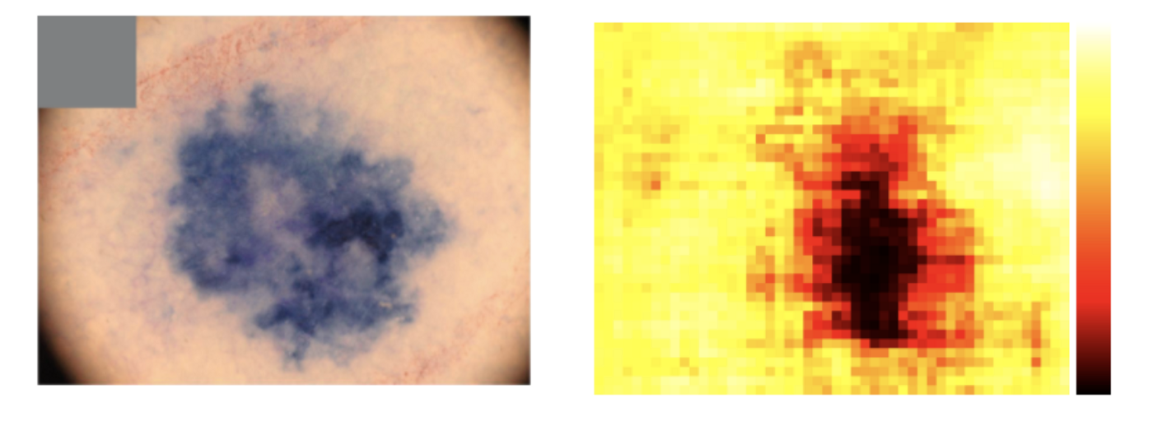
Local interpretability
Goal: Inform the human the reason of the prediction
Basic idea: Change the observations slightly to observe how the prediction will change
LIME // Ribeiro, Singh and Guestrin, 2016
Scott M. Lundberg, Su-In Lee, 2017
Anchors // Ribeiro, Singh and Guestrin, 2018
https://silverpond.com.au/2018/04/17/an-ai-tells-us-what-it-knows-when-we-poke-it-in-the-eye/

Slide 40
Practical 8

